Slide 1


CNN-RNN Forward Proxy Modeling for CO2 monitoring
Team MOMA: Misael Morales & Oriyomi Raheem
GEO 391 – Machine Learning Applications in Geoscience
Spring 2022

Slide 2
Contents
2
Problem statement
Reservoir Simulation
Data Processing
CNN-RNN Proxy Model
Training & Testing
Results, Discussion & Conclusion

Slide 3
Problem statement
3
Question, Problem, and Proposal

Slide 4
Problem Statement
4
Reservoir simulation is crucial for subsurface energy resource engineering
Often, it is very complex and time-consuming
Develop a deep learning framework for forward reservoir simulation
Better computational efficiency
Accuracy trade-off
Exploit latent space dynamics for timelapse predictions using CNN-RNN architecture

Slide 5
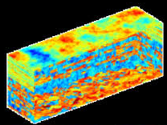



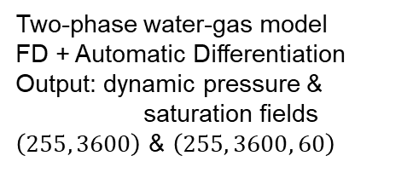
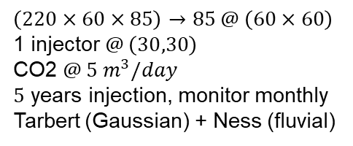
Problem Statement
5
Reservoir Model
(SPE10)
$$\left(220×60×85\right)→85 @ \left(60×60\right)$$
1 injector $@ \left(30,30\right)$
CO2 $@ 5 m^{3}/day$
$5$ years injection, monitor monthly
Tarbert (Gaussian) + Ness (fluvial)
Data Processing
(Python)
Reshape to images
Data augmentation (rotation)
Random Shuffling
Min-Max Normalization
Train/Test split
Numerical Simulation
(MRST)
Two-phase water-gas model
FD + Automatic Differentiation
Output: dynamic pressure & saturation fields
$\left(255, 3600\right)$ & $\left(255, 3600, 60\right)$
Deep Learning
(Keras)
Encoder: Conv2D
Recurrent: GRU
Decoder: Conv3DTranspose
Compile, Fit & Predict

Slide 6
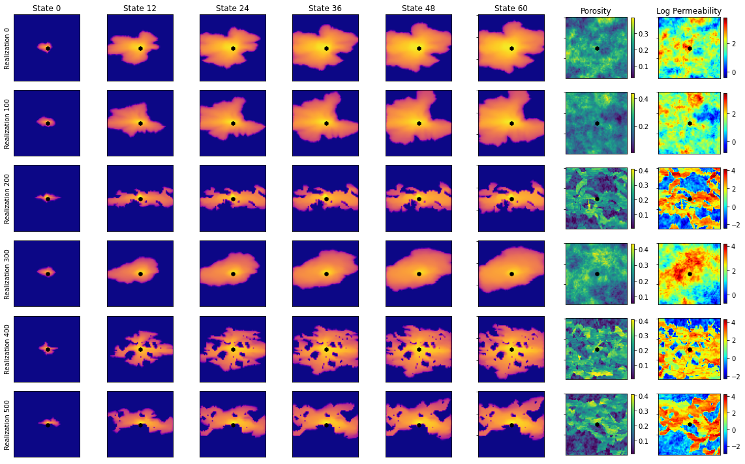
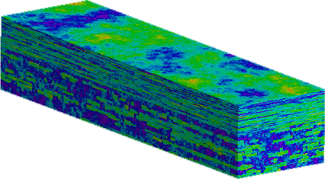
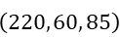

Problem Statement
6
SPE10 model
partition
grid
reservoir
simulation
$$\left(220, 60, 85\right)$$
$$85×\left(60,60\right)$$
CNN-RNN proxy to exploit latent space dynamics
ML
proxy

Slide 7
Reservoir Simulation
7
Model construction and computation

Slide 8
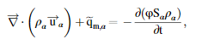
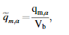
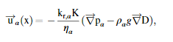
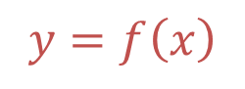
Reservoir Simulation
8
Inputs
Grid
Rock properties
Fluid properties
Initial state
Wells
Boundary conditions
Schedule
Solver
Outputs
Numerical report
Well solution
Pressure states
Saturation states
$$y=f\left(x\right)$$
y
x

Slide 9
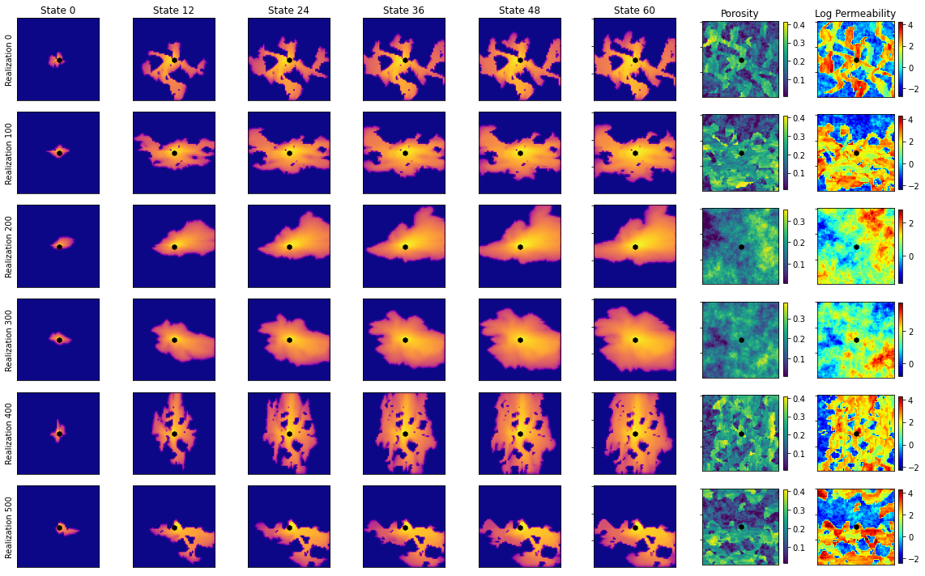
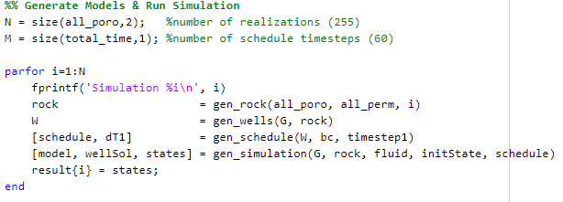
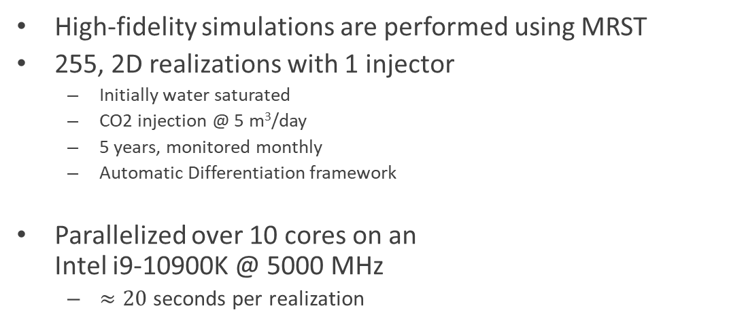
Reservoir Simulation
9
High-fidelity simulations are performed using MRST
255, 2D realizations with 1 injector
Initially water saturated
CO2 injection @ 5 m³/day
5 years, monitored monthly
Automatic Differentiation framework
Parallelized over 10 cores on an Intel i9-10900K @ 5000 MHz
$≈20$ seconds per realization

Slide 10
Data Processing
10
Preparing data for deep learning

Slide 11
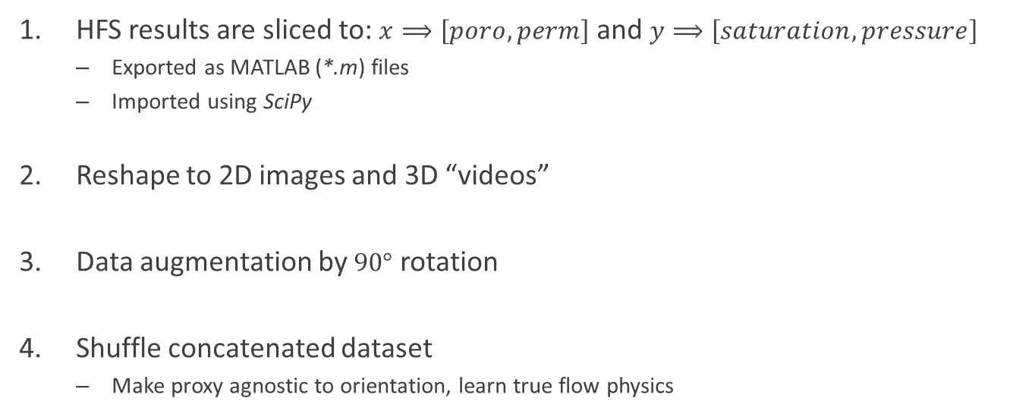
Data Processing
11
HFS results are sliced to: $x⟹\left[poro, perm\right]$ and $y⟹\left[saturation, pressure\right]$
Exported as MATLAB (*.m) files
Imported using SciPy
Reshape to 2D images and 3D “videos”
Data augmentation by $90°$ rotation
Shuffle concatenated dataset
Make proxy agnostic to orientation, learn true flow physics

Slide 12
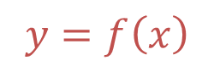
Data Processing
12
$$y=f\left(x\right)$$
x
y

Slide 13
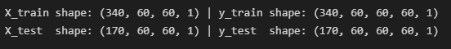
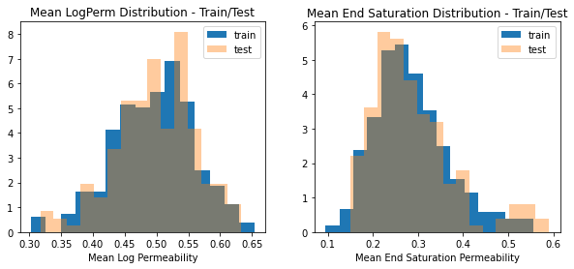
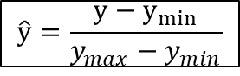
Data Processing
13
Min-Max Normalization
For each realization & for each state:
Train/Test split
Randomly assigned train/test index
$$\hat{y}=\frac{y−y_{min}}{y_{max}−y_{min}}$$

Slide 14
CNN-RNN Proxy model
14
Convolution & Recurrent layers, Latent space representations, and Model building

Slide 15
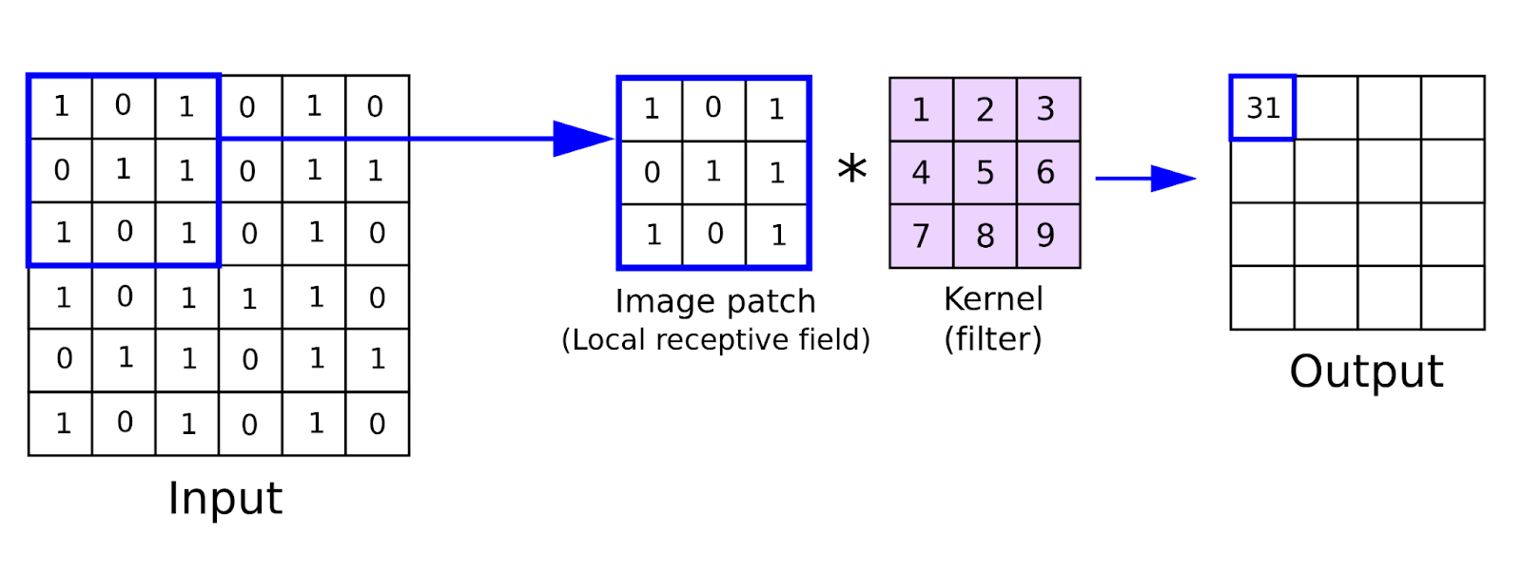
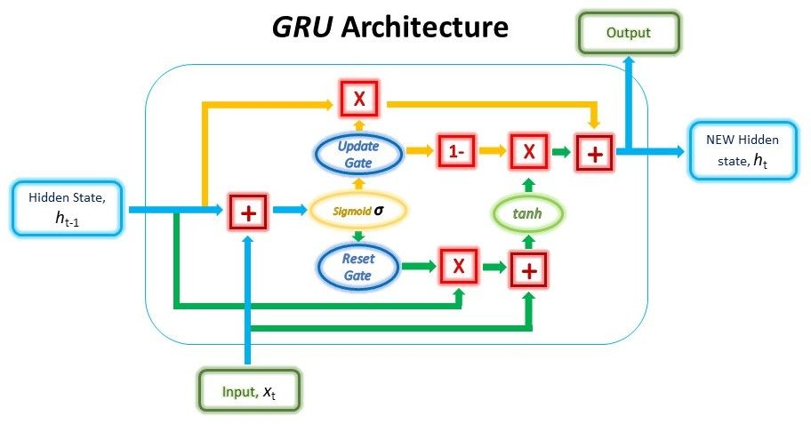
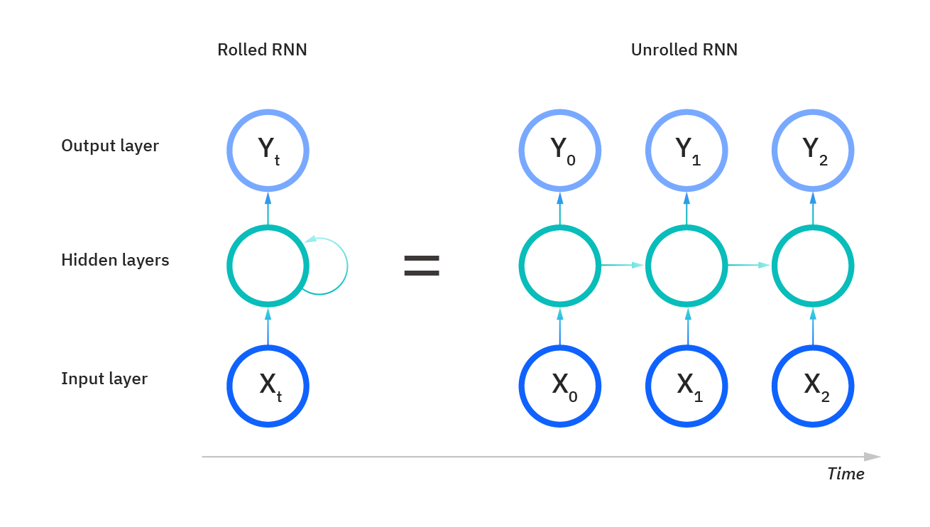

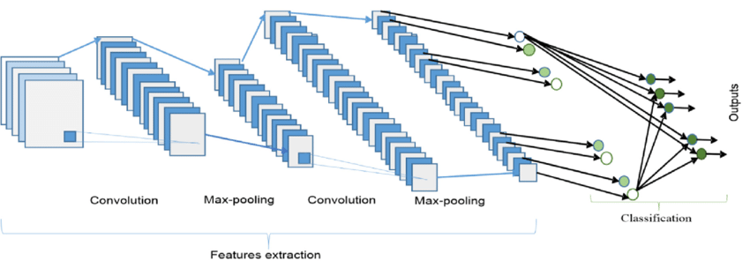
CNN-RNN Proxy Model
15
The convolutional layer
The recurrent layer
Return sequence = True

Slide 16

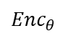


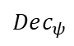
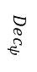



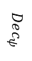

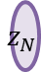

CNN-RNN Proxy Model
16
RNN block
Static input
$$z$$
$$…$$
$$Enc_{θ}$$
$$z_{RNN}$$
$$z$$
$$z_{1}$$
$$z_{2}$$
$$z_{N}$$
$$Enc_{θ}$$
$$Dec_{ψ}$$
$$Dec_{ψ}$$
$$Dec_{ψ}$$
$$Dec_{ψ}$$
Dynamic output
$$…$$
Total # of Parameters: $930,121$

Slide 17
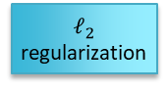
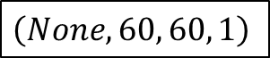

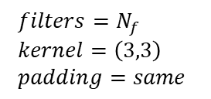
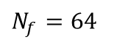
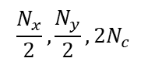
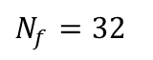
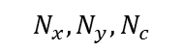
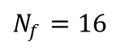
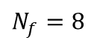
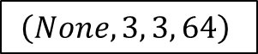
CNN-RNN Proxy Model
17
The Encoder
$$Enc_{θ}$$
$$z$$
Convolutional block
$$\left(None, 60, 60, 1\right)$$
$filters=N_{f}$
$kernel=\left(3,3\right)$
$padding=same$
$ℓ_{2}$ regularization
Conv Block 1
LeakyReLU activation
Conv Block 2
Conv2D
Conv2D
BatchNorm
LeakyReLU
MaxPool2D
Conv Block 3
$$N_{f}=8$$
Conv Block 4
$$N_{f}=16$$
$$\left(None, 3, 3, 64\right)$$
$$N_{f}=32$$
$$\frac{N_{x}}{2},\frac{N_{y}}{2}, 2N_{c}$$
$$N_{f}=64$$
$$N_{x}, N_{y}, N_{c}$$

Slide 18
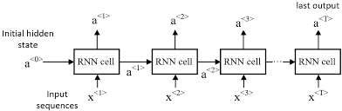
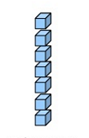

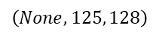
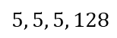
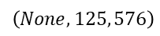
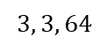
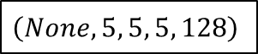
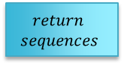
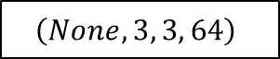
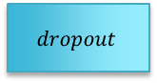
CNN-RNN Proxy Model
18
The Recurrent block
$$z$$
$$z_{RNN}$$
$$\left(None, 3, 3, 64\right)$$
Flatten
Recurrent block
RepeatVector
Flatten
RepeatVector
GRU
Reshape
GRU
Reshape
$$\left(None, 125, 576\right)$$
$$\left(None, 5, 5, 5, 128\right)$$
$$\left(None, 125, 128\right)$$
$$3, 3, 64$$
$$5, 5, 5, 128$$
$$dropout$$
$$return$$
$$sequences$$

Slide 19

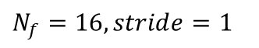

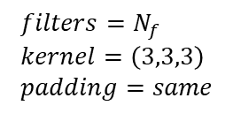
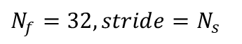









CNN-RNN Proxy Model
19
The Decoder
Transpose Convolutional block
$ℓ_{2}$ regularization
$filters=N_{f}$
$kernel=\left(3,3,3\right)$
$padding=same$
$$z_{𝒹}$$
$$Dec_{ψ}$$
$$\left(None, 5, 5, 5, 128\right)$$
LeakyReLU activation
ConvT Block 1
ConvT3D
ConvT3D
ConvT3D
BatchNorm
LeakyReLU
ConvT Block 2
$$N_{f}=64, stride=1$$
ConvT Block 3
$$N_{f}=32, stride=N_{s}$$
$$2N_{x}, 2N_{y}, 2N_{z},\frac{N_{c}}{N_{s}}$$
Output Block
ConvT3D
$$N_{x}, N_{y}, N_{z},N_{c}$$
$$N_{f}=16, stride=1$$
$$\left(None, 60, 60, 60, 1\right)$$
$$Stride=1$$
$$Stride=N_{s}$$
Conv3D
$$N_{f}=8, sigmoid$$
$$N_{f}=1, sigmoid$$

Slide 20
Training & testing
20
Performance and Visualization

Slide 21




Training & Testing
21
Compile
Optimizer = Nadam (Adam with Nesterov momentum)
Loss = MSE
Fit
Epochs = 300
Batch size = 40
Validation split = 0.25
Workers = 10
$≈17$ minutes on Nvidia RTX 3080

Slide 22

Training & Testing
22
Use trained model to show training predictions
MSE = 0.016 ; SSIM = 0.817

Slide 23

Training & Testing
23
Testing predictions
MSE = 0.040 ; SSIM = 0.563

Slide 24
Results, Discussion & Conclusions
24
Lessons Learned, Possible Applications, and Future Directions

Slide 25
Results, Discussion & Conclusions
25
High-Fidelity Simulations
Crucial yet costly step in reservoir characterization and forecasting
HFS performed in MRST from SPE10 partition
Approximately 20 seconds per realizations
Data Processing
Data: feature (static – permeability) & target (dynamic – saturation)
Augmentation by rotation; Random shuffling; Min-Max Normalization; Train/Test split
Optimized for use in Keras deep learning framework to make proxy model learn the physics of the system

Slide 26

Results, Discussion & Conclusions
26
Proxy Model
Block architecture: Encoder – Recurrent – Decoder
Approximately 930,000 parameters
Each prediction is $≈0.5$ milliseconds $⟹$ $40,000$x speedup!
Results
The proxy model is extremely efficient in predicting dynamic saturation states from a static permeability map.
Train MSE, SSIM = 0.016, 0.817
Test MSE, SSIM = 0.040, 0.563

Slide 27
Results, Discussion & Conclusions
27
Conclusion
Including a SSIM loss function to improve testing predictions
Expand training data through augmentation or generate more realizations
Applications:
Uncertainty quantification
History matching / parameter estimation / model calibration
Closed-loop optimization
Other areas:
Groundwater flows
Contaminant transport
Petroleum production

Slide 28
References
28
Maldonado-Cruz, Eduardo, and Michael J Pyrcz. (2022) “Fast Evaluation of Pressure and Saturation Predictions with a Deep Learning Surrogate Flow Model.” Journal of petroleum science & engineering 212
Kim, Y. D., & Durlofsky, L. J. (2022). "Convolutional-Recurrent Neural Network Proxy for Robust Optimization and Closed-Loop Reservoir Management." arXiv preprint arXiv:2203.07524.
Kaur, Harpreet et al. (2022) “Time-Lapse Seismic Data Inversion for Estimating Reservoir Parameters Using Deep Learning.” Interpretation (Tulsa) 10.1
S. Pan, S.L. Brunton, and J.N. Kutz (2022) "Neural Implicit Flow: a mesh-agnostic dimensionality reduction paradigm of spatio-temporal data." arXiv preprint arXiv:2204.03216
Joon, Shams, Dawuda, Ismael, Morgan, Eugene, and Sanjay Srinivasan. (2022) "Rock Physics-Based Data Assimilation of Integrated Continuous Active-Source Seismic and Pressure Monitoring Data during Geological Carbon Storage." SPE Journal.
Gonzalez, Keyla, and Siddharth Misra. (2022) “Unsupervised Learning Monitors the Carbon-Dioxide Plume in the Subsurface Carbon Storage Reservoir.” Expert systems with applications 201
K.G. Gurjao, E. Gildin, R. Gibson, and M. Everett. (2022) "Estimation of Far-Field Fiber Optics Distributed Acoustic Sensing DAS Response Using Spatio-Temporal Machine Learning Schemes and Improvement of Hydraulic Fracture Geometric Characterization." SPE Hydraulic Fracturing Technology Conference and Exhibition, USA
Salazar, Jose J et al. (2022) “Fair Train-Test Split in Machine Learning: Mitigating Spatial Autocorrelation for Improved Prediction Accuracy.” Journal of petroleum science & engineering 209:109885–.
Tang, Meng, Yimin Liu, and Louis J Durlofsky. (2021) “Deep-Learning-Based Surrogate Flow Modeling and Geological Parameterization for Data Assimilation in 3D Subsurface Flow.” Computer methods in applied mechanics and engineering 376:113636–.
H. Jo, Y. Cho, M.J. Pyrcz, H. Tang, and P. Fu (2021) "Machine learning-based porosity estimation from spectral decomposed siesmic data." arXiv preprint arXiv:2111.13581
Wen, Gege, Catherine Hay, and Sally M Benson. (2021) “CCSNet: A Deep Learning Modeling Suite for CO2 Storage.” Advances in water resources 155:104009–.
Alsulaimani, Thamer , and Mary Wheeler. (2021) "Reduced-Order Modeling for Multiphase Flow Using a Physics-Based Deep Learning." SPE Reservoir Simulation Conference
E.J.R. Coutinho, M.J. Aqua and E. Gildin. (2021) "Physics-Aware Deep-Learning-Based Proxy Reservoir Simulation Model Equipped with State and Well Output Prediction." SPE Reservoir Simulation Conference, Virtual.
Ciriello, V., Lee, J. & Tartakovsky, D.M. (2021) "Advances in uncertainty quantification for water resources applications." Stoch Environ Res Risk Assess 35, 955–957
Pan, W., Torres-Verdín, C. & Pyrcz, M.J. (2021) "Stochastic Pix2pix: A New Machine Learning Method for Geophysical and Well Conditioning of Rule-Based Channel Reservoir Models." Nat Resour Res 30, 1319–1345
Wu, Hao et al. (2021) “A Multi-Dimensional Parametric Study of Variability in Multi-Phase Flow Dynamics During Geologic CO2 Sequestration Accelerated with Machine Learning.” Applied energy 287:116580–.
Santos, J.E., Yin, Y., Jo, H. et al. (2021) "Computationally Efficient Multiscale Neural Networks Applied to Fluid Flow in Complex 3D Porous Media." Transp Porous Med 140, 241–272
Chan, S., Elsheikh, A.H. (2020) "Data-driven acceleration of multiscale methods for uncertainty quantification: application in transient multiphase flow in porous media." Int J Geomath 11,3
Cheung, S.W., Chung, E.T., Efendiev, Y. et al. (2020) "Deep global model reduction learning in porous media flow simulation." Comput Geosci 24, 261–274
Almasov, Azad , Onur, Mustafa , and Albert C. Reynolds. (2020) "Production Optimization of the CO2 Huff-N-Puff Process in an Unconventional Reservoir Using a Machine Learning Based Proxy." SPE Improved Oil Recovery Conference, Virtual
Jiang, Chiyu lmaxr et al. (2020) “MESHFREEFLOWNET: A Physics-Constrained Deep Continuous Space-Time Super-Resolution Framework.” SC20: International Conference for High Performance Computing, Networking, Storage and Analysis. IEEE 1–15.
J. Nagoor Kani, Elsheikh, A.H. (2019) "Reduced-Order Modeling of Subsurface Multi-phase Flow Models Using Deep Residual Recurrent Neural Networks." Transp Porous Med 126, 713–741
Jayne, Richard S, Hao Wu, and Ryan M Pollyea. (2019) “Geologic CO2 Sequestration and Permeability Uncertainty in a Highly Heterogeneous Reservoir.” International journal of greenhouse gas control 83.C:128–139.
K.-A. Lie. (2019) "An Introduction to Reservoir Simulation Using MATLAB/GNU Octave: User Guide for the MATLAB Reservoir Simulation Toolbox (MRST)." Cambridge University Press
Brunton, Steven L., and Jose Nathan Kutz. (2019) "Data-Driven Science and Engineering: Machine Learning, Dynamical Systems, and Control." 1st ed. Cambridge University Press
Guo, Zhenyu, and Albert C Reynolds. (2018) “Robust Life-Cycle Production Optimization With a Support-Vector-Regression Proxy.” SPE journal 23.6:2409–2427
Naraghi, Morteza Elahi, Spikes, Kyle , and Sanjay Srinivasan. (2017) "3D Reconstruction of Porous Media From a 2D Section and Comparisons of Transport and Elastic Properties." SPE Res Eval & Eng 20:342–352
Ampomah, W et al. (2017) “Optimum Design of CO2 Storage and Oil Recovery Under Geological Uncertainty.” Applied energy 195
J. Nagoor Kani, Elsheikh, A.H. (2017) "DR-RNN: A deep residual recurrent neural network for model reduction." arXiv preprint arXiv:1709.00939

Slide 29

Thank you!
29
Questions?
Link to notebook:
https://github.com/misaelmmorales/CNN-RNN-CO2
Misael Morales:
PhD Student in Petroleum & Geosystems Engineering
Advisors: Dr. Michael Pyrcz, Dr. Carlos Torres-Verdin
GitHub | Linkedin | Website | misaelmorales@utexas.edu
Oriyomi Raheem:
PhD Student in Petroleum & Geosystems Engineering
Advisor: Dr. Carlos Torres-Verdin
oriyomiraheem@utexas.edu

Slide 30
Backup slides
30

Slide 31

Simulation Variables
31
Reference pressure: $30$ mega Pascals
Reference temperature: $94℃$
Water compressibility: $0$
Rock compressibility: $4.35×{10}^{−5}$ bars
Water viscosity: $8×{10}^{−4}$ Pascal-second
CO2 viscosity: $5.68×{10}^{−5}$ Pascal-second
Residual water saturation: $0.27$
Residual CO2 saturation: $0.20$
Water viscosity: 1000

Slide 32

Simulation Variables (continued)
32
Grid size: 60x60x1
Grid dimensions: 20x10x5 ft
Initial reservoir pressure: $3000$ psia
Initial reservoir saturation: $\left[0,1\right]$ - $\left[gas,water\right]$
Total simulation time: 5 years
Monitor steps: 1 month
Total steps: 60
Wellbore radius: 0.05
AD Solver: TwoPhaseWaterGasModel

Slide 33
Proxy Model Variables
33
L2 regularization: 1e-4
LeakyReLU alpha: 0.3
RNN dropout: 0.2
Nadam learning rate: 5e-4

